Slide 1
Financial Statements – Ch 2
Outline
The Balance Sheet.
The Income Statement.
Taxes.
Cash Flow.

Slide 2
The Balance Sheet 1
The balance sheet is a financial statement showing a firm’s accounting value on a particular date. (a snapshot of a company’s financial performance at a given point in time)
  Organizes and summarizes what a firm owns (assets), what a firm owes (liabilities), and the difference between the two (equity).

Slide 3
The Balance Sheet 1
Assets are classified as either current or fixed:
  A fixed asset is one that has a relatively long life.
  May be tangible (for example, truck or computer) or intangible (for example, trademark).
  A current asset has a life of less than one year (for example, inventory, cash, accounts receivable).
Liabilities are the first part on the right side of the balance sheet and are classified are either current or long-term.
    Current liabilities have a life of less than one year (due in less than one year) for example Accounts payables.
    Long-term liabilities are debts not due in the coming year.

Slide 4
The Balance Sheet 1
Equity: Shareholders equity (that is, common equity or owners’ equity) is below liabilities on the balance sheet
It is the amount owed to the owners of the company.
Balance sheet “balances” because the value of the left side always equals the value of the right side.
Balance sheet identity or Balance Sheet Equation:
Assets = Liabilities + Stockholders’ Equity.

Slide 5
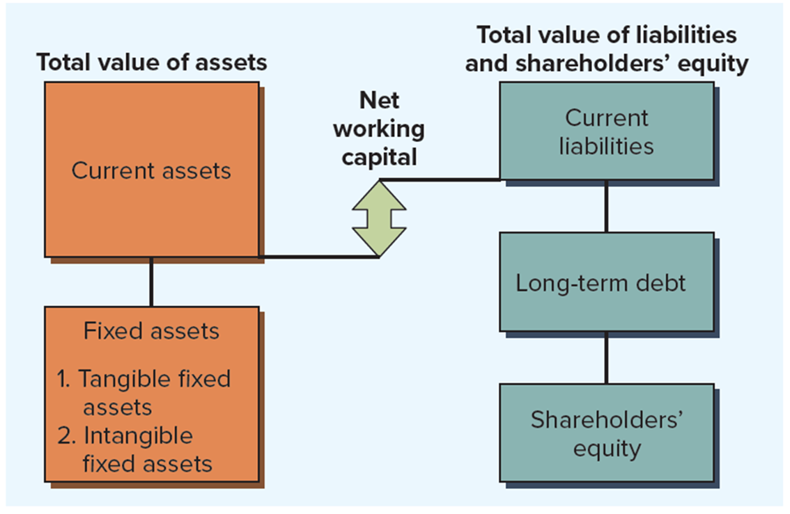
Construction of the Balance Sheet

Slide 6
Net Working Capital
Net working capital is the difference between a firm’s current assets and its current liabilities:
  Positive when cash that will become available over the next 12 months (that is, current assets) exceeds cash that must be paid over the same period (that is, current liabilities).
  Usually positive in a healthy firm.

Slide 7
Three particularly important things to keep in mind when examining a balance sheet:
  Liquidity.
  Debt versus equity.
  Market value versus book value.

Slide 8
Liquidity
Liquidity refers to the speed and ease with which an asset can be converted to cash, without significant loss in value.
  Two dimensions are ease of conversion versus loss of value.
  Highly liquid asset is one that can be quickly sold without significant loss of value, while an illiquid asset is one that cannot be quickly converted to cash without a substantial price reduction.
  Assets are normally listed on the balance sheet in order of decreasing liquidity, with current assets being relatively liquid and fixed assets being relatively illiquid.
  The more liquid a business, the less likely it is to experience financial distress.
  Liquid assets usually do not earn returns.

Slide 9
Debt versus equity
companies primarily have two types of financing as an option, equity financing and debt financing.
Most companies use a combination of debt and equity financing.
Debt financing involves borrowing of money and add fixed financial obligations on the company (interest), whereas equity financing involves selling equity in the company.
With equity financing there is no obligation to repay the money raided through it.
Equity financing places no additional financial burden on the company since there is no obligation to repay such funds.
With debt financing a business owner does not give up any control of the business, as they do with equity financing.

Slide 10
Market Value Versus Book Value
Values on balance sheet for the firm’s assets and equity are book values and generally are not what the assets are actually worth.
  Under generally accepted accounting principles (G A A P), audited financial statements in the U.S. mostly show assets at historical cost (that is, assets are “carried on the book” at what the firm paid for them, no matter how long ago they were purchased or how much they are worth today).
  No necessary connection between total assets shown on the balance sheet and the value of the firm.
For financial managers, accounting value of stock is not especially important; it is the market value that matters.
  Market value of an asset depends on things like its riskiness and cash flows, neither of which have anything to do with accounting.

Slide 11
U.S. Corporation 2023 and 2024 Balance Sheets
U.S. CORPORATION
2023 and 2024 Balance Sheets (in $ millions)
 | Assets |  | Liabilities and owners’ Equity
 | 2023 | 2024 |  | 2023 | 2024
Current assets |  |  | Current liabilities
Cash | $ 104 | $ 221 | Accounts payable | $ 232 | $ 266
Accounts receivable | 455 | 688 | Notes payable | 196 | 123
Inventory | 553 | 555 | Total | $ 428 | $ 389
Total | $1,112 | $1,464
Fixed assets
Net plant and equipment | $1,644 | $1,709 | Long-term debt | $ 408 | $ 454
 |  |  | Owners’ equity
 |  |  | Common stock and paid-in surplus | $ 600 | $ 640
 |  |  | Retained earnings | 1,320 | 1,690
 |  |  | Total | $1,920 | $2,330
Total assets | $2,756 | $3,173 | Total liabilities and owners’ equity | $2,756 | $3,173

Slide 12
Income Statement
The income statement is a financial statement summarizing a firm’s performance over a period of time, usually a quarter or a year. (video rather than snapshot)
Income statement equation is:
Revenues − Expenses = Income
First part reported on income statement would usually be revenue and expenses from the firm’s principal operations.
  Subsequent parts include, among other things, financing expenses such as interest paid.
  Taxes are reported separately.
  Last item is net income (that is, “the bottom line”).

Slide 13
U.S. Corporation: Income Statement
U.S. CORPORATION
2024 Income Statement (in millions)
Net sales |  | $1,509
Cost of goods sold |  | 750
Depreciation |  | 65
Earnings before interest and taxes (Operating Income) |  | $ 694
Interest paid |  | 70
Taxable income |  | $ 624
Taxes (21%) |  | 131
Net income |  | $ 493
Dividends | $ 123
Addition to retained earnings | 370
As indicated, U.S. Corporation paid cash dividends of $123. The difference between net income and cash dividends, $370, is the addition to retained earnings for the year. This amount is added to the cumulative retained earnings account on the balance sheet. If you look back at the two balance sheets for U.S. Corporation, you’ll see that retained earnings did go up by this amount: $1,320 + 370 = $1,690.

Slide 14
The Income Statement 2
A financial manager should keep three things in mind when looking at an income statement:
  GAAP (generally accepted accounting principle)
  As a result of the way revenues and expenses are realized, income statement figures may not be representative of actual cash inflows/outflows that occurred during a particular period. the recognition or realization principle
Cash versus noncash items:
    Noncash items are expenses charged against revenues that do not directly affect cash flow, such as depreciation and depletion.
    Crucial to separate cash flows from noncash accounting entries.
Time and costs.
    Product costs (operating costs) include things such as raw materials, direct labor expense, and manufacturing overhead.
    Period costs are incurred during a particular time period and might be reported as selling, general, and administrative expenses.
    Financial accountants do not distinguish between variable costs and fixed costs. Instead, accounting costs usually fit into a classification that distinguishes product costs from period costs.

Slide 15
The generally accepted accounting principles (GAAP)
The generally accepted accounting principles (GAAP) are a set of accounting rules, standards, and procedures issued and frequently revised by the Financial Accounting Standards Board (FASB) and the Governmental Accounting Standards Board (GASB).
The matching principal GAAP requires that we recognize revenue when it is earned, not when the cash is received, and we match costs to revenues. This introduces noncash deductions such as depreciation and amortization. Consequently, net income is NOT the same as cash flow.

Slide 16
Taxes
Taxes can be one of the largest cash outflows a firm experiences.
  Size of a company’s tax bill is determined by the tax code, an often amended set of rules.
Federal corporate tax rates became a flat 21% after the passage of the Tax Cuts and Jobs Act of 2017.
  Tax rates on other forms of business (for example, proprietorships, partnerships, and L L C’s) did not become flat.
Average tax rate is calculated as total taxes paid divided by total taxable income, while the marginal tax rate is the amount of tax payable on the next dollar earned.
Marginal tax rate It is the tax rate that applies to the next dollar earned and is a critical concept in understanding tax systems.

Slide 17
Cash Flow
Cash flow means the difference between the number of dollars that came in and the number of dollars that went out.
No standard financial statement presents this information in the way that we need (more about that later).
  Statement of cash flows is a standard financial accounting statement, but it is concerned with a somewhat different issue.
Cash flow identity says the cash flow from the firm’s assets is equal to the cash flow paid to suppliers of capital to the firm:
Cash flow from assets = Cash flow to creditors + Cash flow to stockholders
Cash flow identity reflects the fact that a firm generates cash through its various activities, and that cash is either used to pay creditors or paid out to the owners of the firm.

Slide 18
Cash Flow from Assets 1
Cash flow from assets (CFFA) is the total of cash flow to creditors and cash flow to stockholders, consisting of the following three components:
  Operating cash flow refers to cash generated from a firm’s normal business activities.
  Capital spending refers to the net spending on fixed assets (purchases of fixed assets less sales of fixed assets).
  Change in net working capital is measured as the net change in current assets relative to current liabilities for the period being examined and represents the amount spend on net working capital.
Cash flow from assets is sometimes called free cash flow (FCF), referring to the cash the firm is “free” to distribute to creditors and stockholders because it is not needed for working capital or fixed asset investments.

Slide 19
Cash Flow from Assets
Operating cash flow is calculated as revenues minus costs and tells us whether a firm’s cash inflows from its business operations are sufficient to cover its everyday cash outflows.
  Do not include depreciation or interest in the calculation but be sure to include taxes.
  Negative operating cash flow is a sign of trouble.
  Different calculation used for operating cash flow in accounting.
Net capital spending (that is, CAPEX) is money spent on fixed assets less money received from the sale of fixed assets.
  Could be negative is the firm sells more assets than it purchases.
Change in net working capital is found by taking the difference between the beginning and ending net working capital (N W C) figures.
  Often referred to as the “addition to” N W C.

Slide 20
Cash Flow from Assets
      Cash flow from Assets = Cash flow to creditors + Cash flow to stockholders
      CFFA = Operating cash flow − Net capital spending − Changes in net working capital
      1. Operating cash flow (OCF) = EBIT + Depreciation − Taxes
      2. Net capital spending (NCS) = Ending fixed assets − Beginning fixed assets + Depreciation
      3. Changes in NWC = Ending NWC − Beginning NWC

Slide 21
U.S. Corporation 2023 and 2024 Balance Sheets
U.S. CORPORATION
2023 and 2024 Balance Sheets (in $ millions)
1,075m = 1464m- 389m
 | Assets |  | Liabilities and owners’ Equity
 | 2023 | 2024 |  | 2023 | 2024
Current assets |  |  | Current liabilities
Cash | $ 104 | $ 221 | Accounts payable | $ 232 | $ 266
Accounts receivable | 455 | 688 | Notes payable | 196 | 123
Inventory | 553 | 555 | Total | $ 428 | $ 389
Total | $1,112 | $1,464
Fixed assets
Net plant and equipment | $1,644 | $1,709 | Long-term debt | $ 408 | $ 454
 |  |  | Owners’ equity
 |  |  | Common stock and paid-in surplus | $ 600 | $ 640
 |  |  | Retained earnings | 1,320 | 1,690
 |  |  | Total | $1,920 | $2,330
Total assets | $2,756 | $3,173 | Total liabilities and owners’ equity | $2,756 | $3,173
684m = 1,112m- 428m

Slide 22
U.S. Corporation: Income Statement
U.S. CORPORATION
2024 Income Statement (in millions)
Net sales |  | $1,509
Cost of goods sold |  | 750
Depreciation |  | 65
Earnings before interest and taxes (Operating Cash Flow) |  | $ 694
Interest paid |  | 70
Taxable income |  | $ 624
Taxes (21%) |  | 131
Net income |  | $ 493
Dividends | $ 123
Addition to retained earnings | 370

Slide 23
Cash Flow from Assets 3
U.S. CORPORATION
2024 Cash Flow from Assets
Operating cash flow | $628
− Net capital spending | 130
− Change in N W C | 391
Cash flow from assets | $107
From Income statement
$1,709-$1,644+65 (dep)
$1,075-$684 BS
The total cash flow from assets is given by operating cash flow (694) less the amounts invested in fixed assets and net working capital.

Slide 24
Cash Flow to Creditors (bondholders) and Stockholders
Cash flow to creditors = Interest paid − Net new borrowing = Interest paid − (Ending long-term debt − Beginning long-term debt)
Cash flow to stockholders = Dividends paid − Net new equity raised = Dividends paid − (Ending common stock, APIC, & Treasury stock − Beginning common stock, APIC, & Treasury stock)
It is important to point out that changes in retained earnings are not included in “net new equity raised.” The effect of this increase is captured in changes in net working capital and net capital spending.

Slide 25
Cash Flow to Creditors and Stockholders
Cash flow to creditors is calculated as a firm’s interest payments to creditors less net new borrowing.
  Sometimes called cash flow to bondholders.
U.S. CORPORATION
2024 Cash Flow to Creditors
Interest paid | $70
− Net new borrowing | 46
Cash flow to creditors | $24
Income statement
Balance Sheet
Cash flow to stockholders is calculated as dividends paid out by a firm less net new equity raised.
U.S. CORPORATION
2024 Cash Flow to Stockholders
Dividends paid | $123
− Net new equity raised | 40
Cash flow to stockholders | $ 83
Income statement
BS 640-600

Slide 26
Cash Flow - updated since last posting
Cash Flow from Assets
Operating cash flow
$628
− Net capital spending
130
− Change in N WC
391
Cash flow from assets $107
Cash Flow to Creditors
Interest paid | $70
Net new borrowing | 46
Cash flow to creditors | $24
Cash flow to stockholders
Dividends paid | $123
− Net new equity raised | 40
Cash flow to stockholders | $83

Slide 27
Cash Flow Summary
1. The cash flow identity
Cash flow from assets = Cash flow to creditors (bondholders) + Cash flow to stockholders (owners)
2. Cash flow from assets
Cash flow from assets = Operating cash flow − Net capital spending − Change in net working capital (N W C) where: Operating cash flow = Earnings before interest and taxes (E B I T) + Depreciation − Taxes Net capital spending = Ending net fixed assets − Beginning net fixed assets + Depreciation Change in NWC = Ending NWC − Beginning N W C
3. Cash flow to creditors (bondholders)
Cash flow to creditors = Interest paid − Net new borrowing
4. Cash flow to stockholders (owners)
Cash flow to stockholders = Dividends paid − Net new equity raised

